Slide 1
Image Caption Generator - Project Outline

Slide 2

Presented by :
Team Perfect Squares:
Durgesh Mishra
Jai Saxena
Niranjan Solanki
Pankaj Balchandani

Slide 3
Problem Statement
Image Captioning is the process of generating a textual description for given images. A challenging problem in Deep learning is to auto-generate caption for an image.
To understand the context of an image and describe it in a human language like English, Image Caption Generator uses both Natural Language Processing (NLP) and Computer Vision to generate the captions.

Slide 4
Outline
Problem Statement
Problem Approach
Project Workflow
Dataset & Models
Exploratory Data Analysis (EDA)
Data preprocessing
Implementation & results

Slide 5
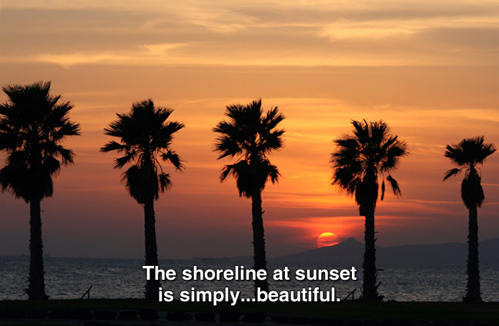
Problem Approach
We plan to build a user interface where given an image, we generate the relevant caption for that particular image using Computer vision & NLP-based models.

Slide 6
Project Scope
Proof Of Concept (POC)
Prototype
Minimum Viable Product (MVP)
Preprocess Image and Caption data
Experiment on some baseline models and approaches.
Visualize model activations to analyse whether the captions. generated are relevant or not.
Check for pixels in a given image that contributes to the captions & segment the given pixels.
Create a mockup of screens to see how the app could look like
Deploy one model to Fast API to service model predictions as an API
Create App to generate caption for an uploaded image
API Server for uploading images and predicting using best model

Slide 7
Project Workflow
POC
Prototype
MVP
Data Collection
Setup Experiment Tracking
Build Baseline Models
Build better Models
Project, Containers, Deployment Setup
Build Caption generating App

Slide 8
Datasets & Models
We plan to experiment with the two datasets:
Flickr 8K (8,000 images) & Flickr 32k (31,000 images) (https://www.kaggle.com/code/hsankesara/image-captioning/data)
Coco Caption (328k images) (https://paperswithcode.com/dataset/coco)
Models:
Convolutional Neural Network based models
Language based models

Slide 9
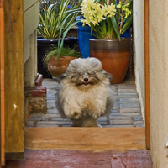
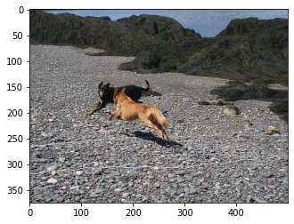
EDA
Total number of Images: 8000
Captions per Image: 5
Image sizes vary from
148 to 500 pixels in x
164 to 500 pixels in y
'<s> a furry dog is running through a doorway leading to plants </s>',
'<s> a furry tan dog is outside on a patio </s>',
'<s> a short furry dog stands on a brick floor in front of a group of potted plants </s>',
'<s> a very hairy dog is running down a hall </s>',
'<s> flowers are behind the fluffy dog that is coming up the step </s>'
brown dog is running after the black dog

Slide 10
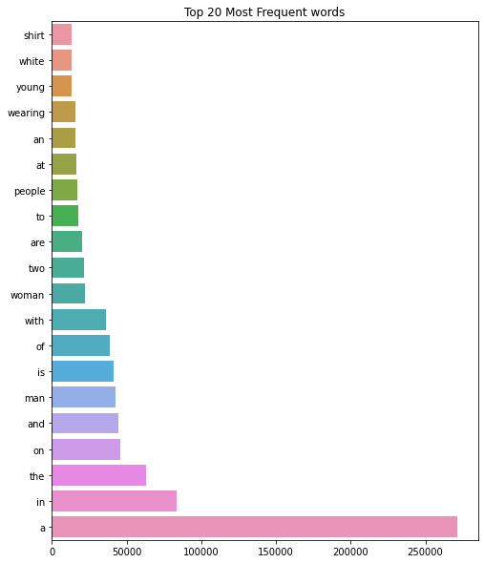
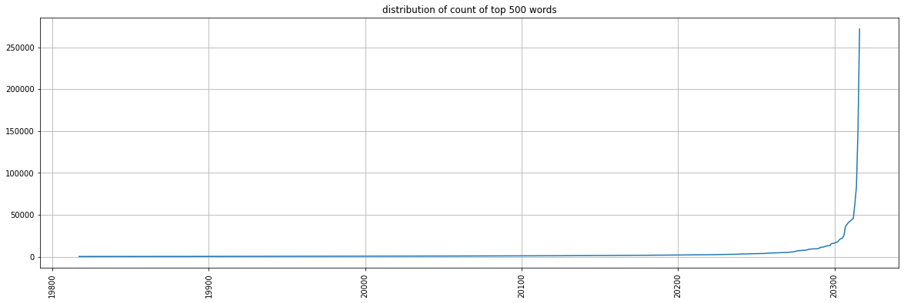
EDA
Dictionary size: 5000
Distribution of top 500 words

Slide 11
Preprocessing
Preprocessing of Images:
Applied data augmentation
Initial Implementation:
Each Image was compressed to (60,60,3)
After understanding of RAM consumption:
Each Image was compressed to (120,120,3)
Preprocessing of Text:
Initial Implementation:
Text was preprocessed to remove unwanted characters.
After Understanding the varying text length of captions:
Text >15 length and text <5 length were removed for less sparsity.

Slide 12
Model
Computer vision task:
Small, Medium, Large CNN based models
Transfer learning: Resnet50 model
Language modeling task:
RNN,LSTM

Slide 13
Models - Training Results
S.no | Model | Epochs | Data subset size | Learning rate | Optimizer | Batch_size | Accuracy | Loss
1 | CNN2D 4 Layer + LSTM 1 Layer | 10 | 10000 Images | 0.001 | Adam | 32 | 27% | 2.93
2 | CNN2D 6 Layer + LSTM 1 Layer | 10 | 10000 Images | 0.001 | Adam | 64 | 28% | 2.84
3 | CNN2D 8 Layer + LSTM 1 Layer | 10 | 20000 Images | 0.001 | Adam | 64 | 29% | 2.85
4 | Resnet50 + LSTM 1 Layer (preserving all weights of conv layers ) | 10 | 20000 Images | 0.001 | Adam | 128 | 28% | 2.83
5 | Resnet50 + LSTM 1 Layer (training last convolution layer) | 10 | 20000 Images | 0.001 | Adam | 128 | 32% | 2.724
Above accuracy measure is the measure of how good the model is predicting new word but since each image has 5 different captions accuracy could go down. Will come with more reliable accuracy measure.

Slide 14

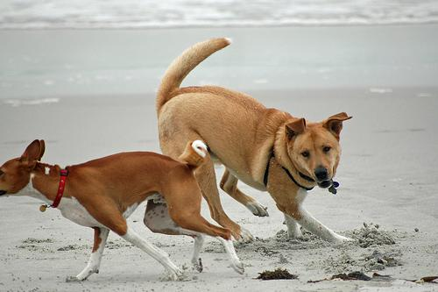

Screenflow & Wireframes
Image Caption Generator
Image Caption Generator
Image Caption Generator
Upload a photo or take a picture
Generate Captions
Two dogs playing together on beach .
UPLOAD

Slide 15



Solution Architecture
Process
Model training
Upload picture, view predictions
Execution
(Human Interactions)
(Human Interactions)
Colab
Frontend
Notebooks
Caption Generator App
(HTTP)
(HTTP)
(HTTP)
Backend
Data Collector
Model Tracking
API Service
State
(Protocol specific)
Database
Images Store
Model Store

Slide 16
Technical Architecture
Developers
Data Scientists
Users
IDE/ CLI
Browser
Browser
HTTPS 443
HTTP 80
Colab
Source Control
Single Compute Instance/ Kubernetes Cluster
GitHub
Notebooks
HTTP 80
HTTP 9000
NGINX Container
API Service Container
HTTP 3000
GCP
HTTPS 443
Google Container Registry
Caption Generator App Container
GCS Bucket
TCP/IP 5432
Database Container
Caption Generator App Image
Models
API Service Image
HTTPS 443
NFS
Download Collector Image
GCE Persistent Volume
HTTPS 443
Database Disk

Slide 17
Thank you!!

Slide 18
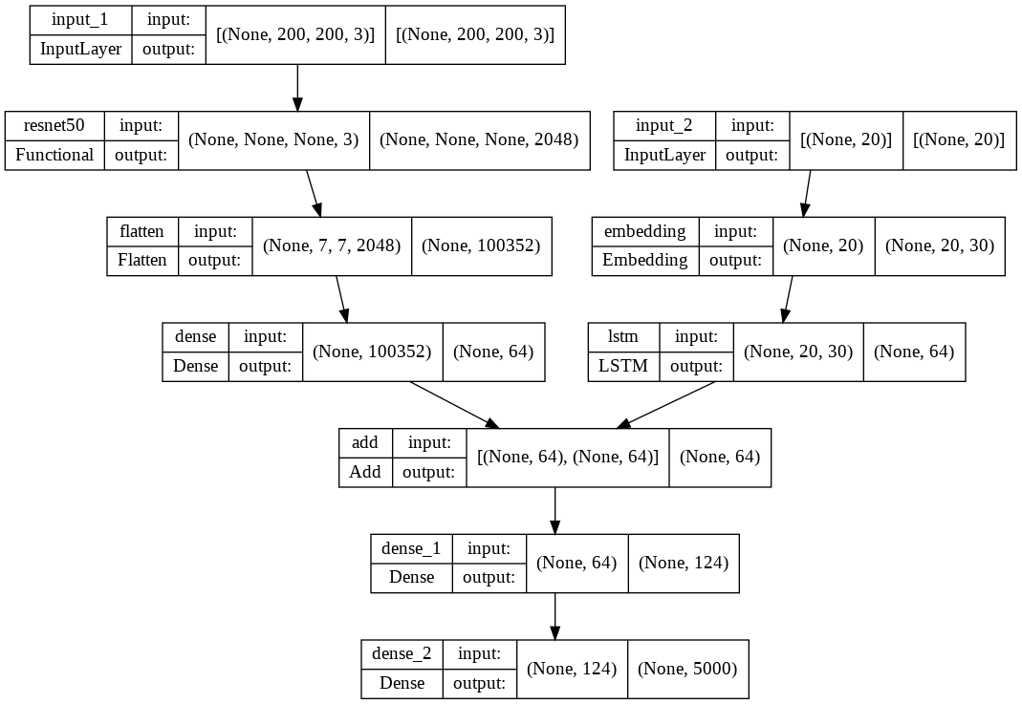
Basic model architecture:

